Slide 1


Slide 2

Anek Creations
Second Year Project Synopsis
Submitted by
ROLL NUMBER | NAME
2301010346 | ARCHI GARG
2301010343 | VARTIKA VERMA
2301010345 | ADITYA PORWAL
2301010406 | YANKILA BISHT
Industry Mentor: Mr. Deepak Singh
Faculty Mentor: Ms. Suman
Notes:
New Courses replaced with New Programmes

Slide 3

Project Overview
This project aims to develop a user-friendly e-commerce website for Anek Creations that specializes in handmade and customized items, expanding its current offline presence to the digital space. The online platform will showcase the store’s unique product range with high-quality images, detailed descriptions and personalization options, enabling customers to explore and purchase from any location.
Notes:
New Courses replaced with New Programmes

Slide 4
Problem statement
Due to low footfall at the offline store, Anek Creation faced scalability issues in the ever-growing market space of handmade craft items. In order to provide an easy-to-use solution, after thoughtful discussion we as a team prompted the idea of creating a website that would aim to increase the order rate and serve as basis of future business expansions.
Notes:
New Courses replaced with New Programmes

Slide 5
Objectives
📱 Ensure Responsive & Mobile-Friendly Design
Create a seamless user experience across devices (mobile, tablet, desktop), as a large portion of e-commerce traffic comes from mobile users.
🎨 Deliver Intuitive User Interface (UI)
Design clean navigation, search filters, product pages, and checkout flows that are user-centric and improve conversion rates.
👥 Implement User Authentication & Profiles
Allow users to register, log in, view order history, and save preferences using secure and efficient authentication mechanisms.
Notes:
New Courses replaced with New Programmes

Slide 6
Methodology, Tools, and Techniques
Approach taken to solve the problem
Due to low footfall at the offline, Anek Creation faced scalability issues in the ever growing market space of handmade craft items. In order to provide an easy to use solution, after thoughtful discussion we as a team prompted the idea of creating a website that would aim to increase the order rate and serve as basis of future business expansions.
We planned to take on a collaborative approach for completing this project by taking combined efforts for creating each part of the project.
Tools & Software Used:
Design & Prototyping: Creately ,Canva,Sketches,tailingwind
Development: HTML, CSS, JavaScript, React, Nest.js
Database: MySQL
Notes:
New Courses replaced with New Programmes

Slide 7
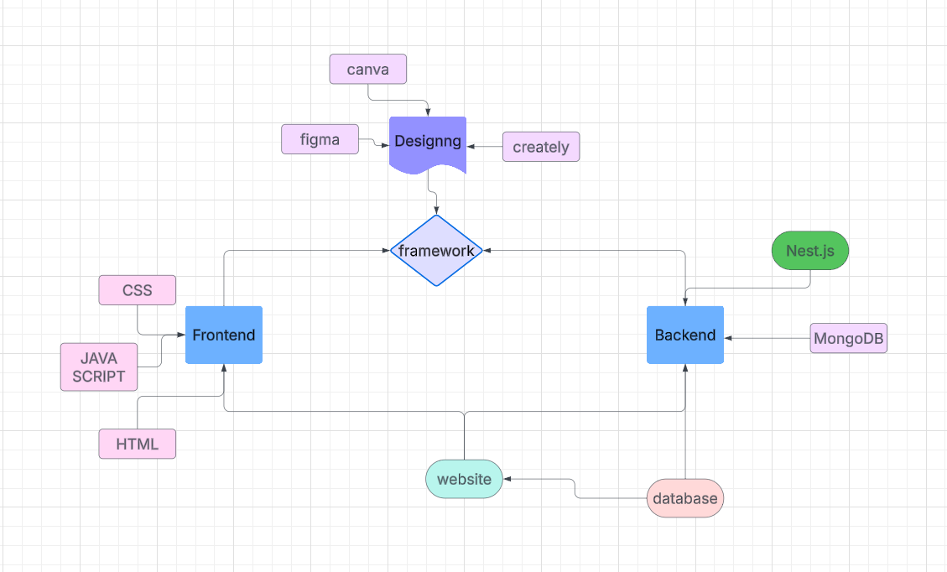
Methodology Flowchart
Notes:
New Courses replaced with New Programmes

Slide 8
Expected Results and Impacts
Increased Sales & Revenue – Expand customer reach beyond the offline store, leading to higher order volume and revenue growth.
Enhanced Brand Visibility – Establish a strong online presence, attracting a wider audience through digital marketing, SEO, and social media.
Improved Customer Experience – Provide a seamless, user-friendly shopping platform with easy navigation, and order tracking.
Customization & Personalization – Offer customers the ability to personalize products, increasing engagement and satisfaction.
Expanded Market Reach – Enable nationwide and potentially international sales, overcoming geographical limitations of the offline store.
Notes:
New Courses replaced with New Programmes

Slide 9
THANK YOU

